Slide 1
WELCOME TO THE AIUSA MONTHLY MEMBER CALL!
This call will be recorded. While you’re waiting…
TAKE ACTION TO END GUN VIOLENCE:
heroes.amnestyusa.org
TURN ON VIDEO & MAKE SURE YOUR MIC IS MUTED
INTRODUCE YOURSELF IN THE CHAT!
NAME, PRONOUNS & CITY/STATE
DISABLE OR ENABLE SUBTITLES

Slide 2
LGBTI Human Rights
Ian Lekus (he/him)
LGBTI Thematic Specialist
iklekus@gmail.com
2021 Pride page:
https://www.amnestyusa.org/pride-2021/
LGBTI Human Rights all year long
LGBTI human rights are human rights
LGBTI human rights are the fundamental rights – of speech, assembly, political activity, & to full participation in society – at the core of Amnesty’s mission
LGBTI people’s rights are intertwined with the human rights of other groups (e.g., women, refugees & migrants, many more)
LGBTI human rights: the canary in the coalmine

Slide 3
AIUSA Monthly Member Call
Global Gag Rule/Global HER Act
© Amnesty International USA, 2018 – May not be distributed or reproduced without prior permission

Slide 4
Global GAG – what is it?
History: US support for medical care and access to contraception
Foreign affairs policy that cuts most global US health funding to providers who provide abortion education and counseling to patients/visitors
Politics > Health
Limits on free speech of global health providers = global gag
Expanded under former President Trump
Rescinded (temporarily) under President Biden
© Amnesty International USA, 2018 – May not be distributed or reproduced without prior permission
Notes:
Additional points
Point 1: Please practice our ask and keep it brief. Refer to issue brief on what the asks are. (Facilitator could state an example of what an ask sounds like) Additionally, you don’t have to mention all the asks. Pick 2-3 that resonates with you most and focus on that.
Point 2: Make sure to give the issue brief after the ask has been made because there is a tendency for MOC/staffer to immediately read the issue brief, which may be distracting to your ask.
Point 3: Remember, this is the main reason why you are here so you want to make sure to clearly repeat your ask just in case they were distracted reading the issue brief.

Slide 5
Global GAG – consequences
1.7 million unsafe abortions
20,000 avoidable maternal deaths
70 million fewer condoms distributed
Reduced services for those in rural areas
Successful PEPFAR HIV programs shut down
GBV-based services blocked for survivors
© Amnesty International USA, 2018 – May not be distributed or reproduced without prior permission
Notes:
Additional points
Point 1: Please practice our ask and keep it brief. Refer to issue brief on what the asks are. (Facilitator could state an example of what an ask sounds like) Additionally, you don’t have to mention all the asks. Pick 2-3 that resonates with you most and focus on that.
Point 2: Make sure to give the issue brief after the ask has been made because there is a tendency for MOC/staffer to immediately read the issue brief, which may be distracting to your ask.
Point 3: Remember, this is the main reason why you are here so you want to make sure to clearly repeat your ask just in case they were distracted reading the issue brief.

Slide 6
Global HER – solution
Global Health, Empowerment and Rights (HER) Act → S. 142 and H.R. 556
Permanently ends Global Gag
Allows NGOs abroad to use non-US funding to provide critical health-related services, so long as those services are legal in the US and provider country
Erases discriminatory restrictions and promotes ethical and safe practices
Supports freedom of speech and stigma-free health care
Promotes comprehensive reproduction health care and protects patient right to informed choice
© Amnesty International USA, 2018 – May not be distributed or reproduced without prior permission
Notes:
Additional points
Point 1: Please practice our ask and keep it brief. Refer to issue brief on what the asks are. (Facilitator could state an example of what an ask sounds like) Additionally, you don’t have to mention all the asks. Pick 2-3 that resonates with you most and focus on that.
Point 2: Make sure to give the issue brief after the ask has been made because there is a tendency for MOC/staffer to immediately read the issue brief, which may be distracting to your ask.
Point 3: Remember, this is the main reason why you are here so you want to make sure to clearly repeat your ask just in case they were distracted reading the issue brief.

Slide 7
What Can YOU Do?
Week of Action: June 21-25 #endgagnow
Call your Senator and ask them to co-sponsor Global HER (S. 142) and urge that it be passed through the Appropriations Bill
Visit our toolkit for additional actions (Twitter actions, letters to the editor)
© Amnesty International USA, 2018 – May not be distributed or reproduced without prior permission
Notes:
Additional points
Point 1: Please practice our ask and keep it brief. Refer to issue brief on what the asks are. (Facilitator could state an example of what an ask sounds like) Additionally, you don’t have to mention all the asks. Pick 2-3 that resonates with you most and focus on that.
Point 2: Make sure to give the issue brief after the ask has been made because there is a tendency for MOC/staffer to immediately read the issue brief, which may be distracting to your ask.
Point 3: Remember, this is the main reason why you are here so you want to make sure to clearly repeat your ask just in case they were distracted reading the issue brief.

Slide 8
Through it all…
Stay persistent!
Stay engaged!
Your efforts make a HUGE difference in the fight for human rights – THANK YOU!
© Amnesty International USA, 2018 – May not be distributed or reproduced without prior permission

Slide 9
LGBTI Human Rights: Vitalina Koval www.amnestyusa.org/pride-2021/#vitalina

Slide 10
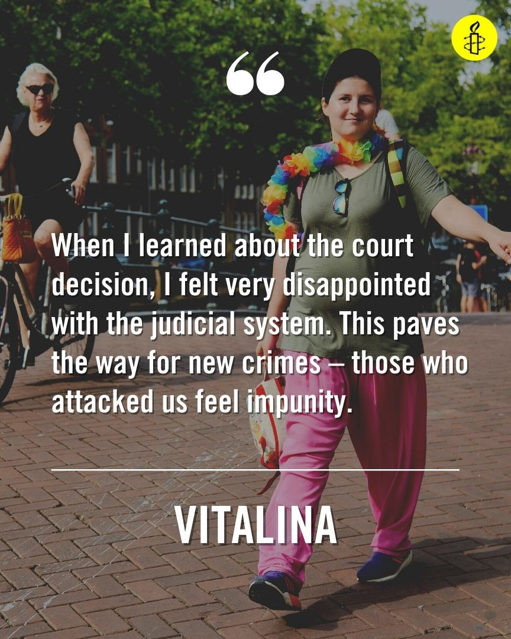
LGBTI Human Rights: Vitalina Koval www.amnestyusa.org/pride-2021/#vitalina

Slide 11
LGBTI Human Rights: Vitalina Koval www.amnestyusa.org/pride-2021/#vitalina

Slide 12
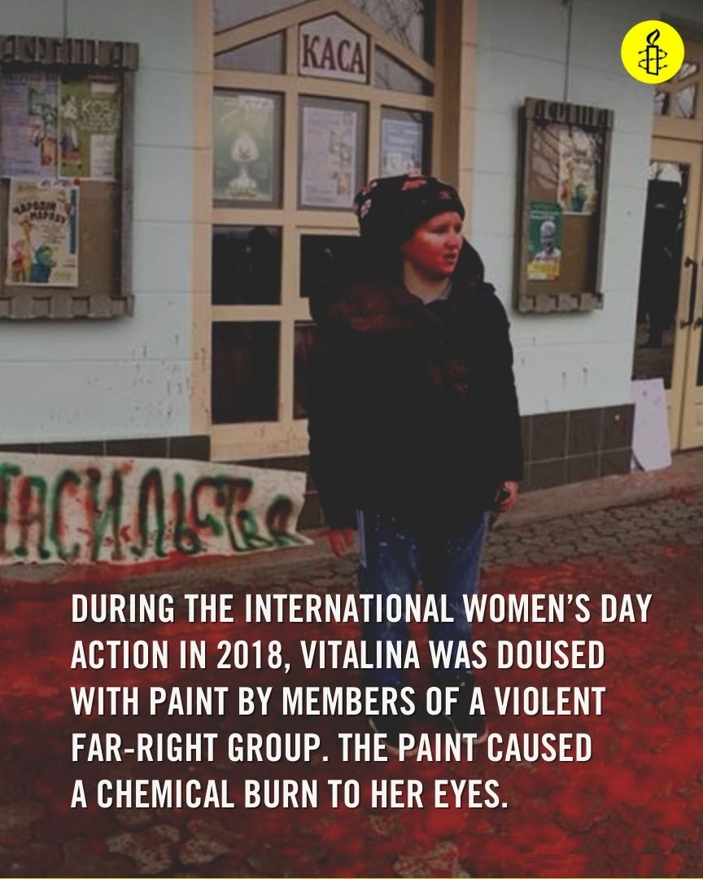
LGBTI Human Rights: Vitalina Koval www.amnestyusa.org/pride-2021/#vitalina

Slide 13
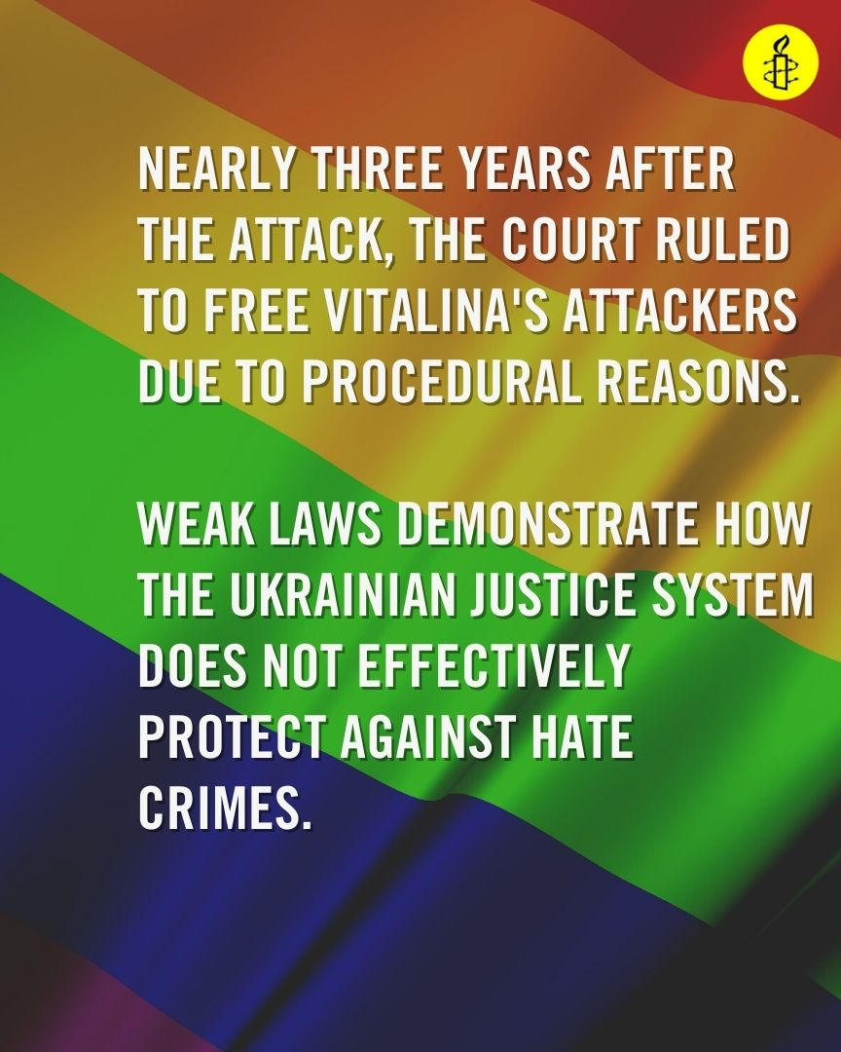
LGBTI Human Rights: Vitalina Koval www.amnestyusa.org/pride-2021/#vitalina

Slide 14
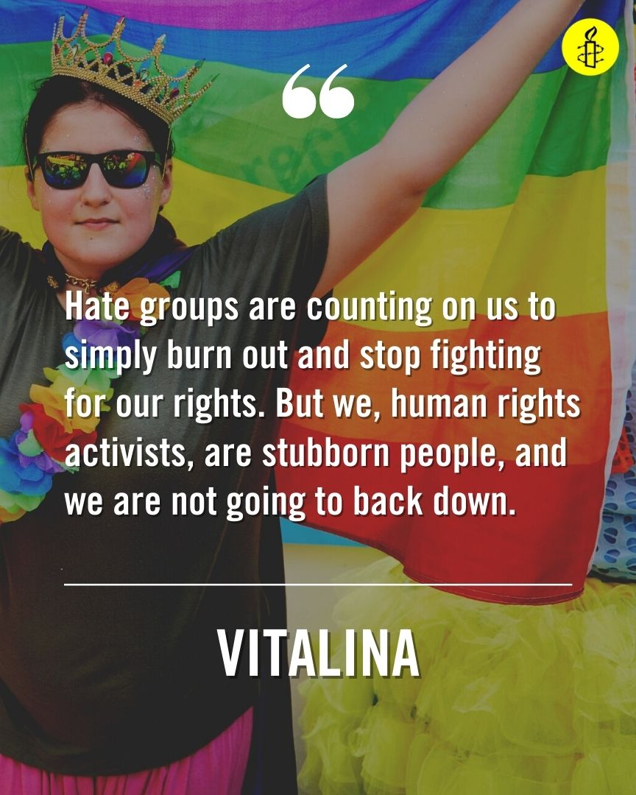
LGBTI Human Rights: Vitalina Koval www.amnestyusa.org/pride-2021/#vitalina

Slide 15
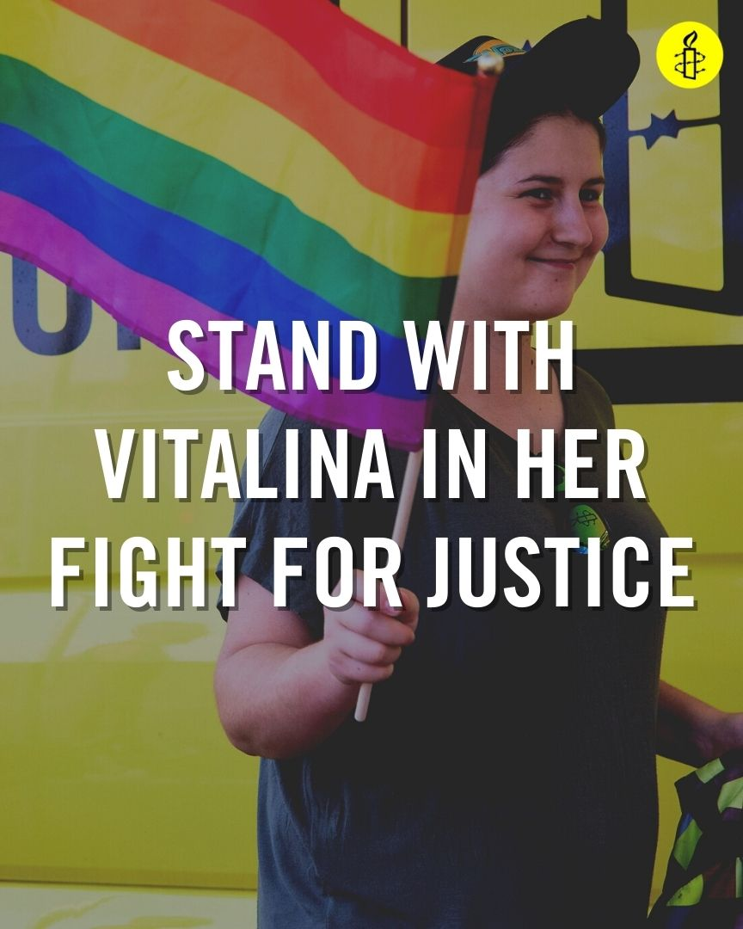
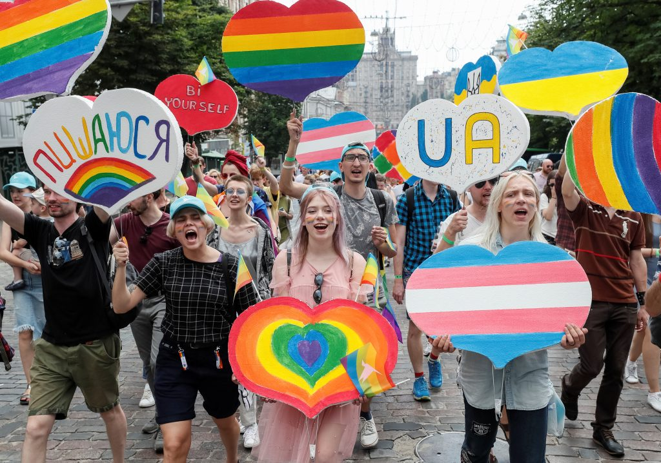
LGBTI Human Rights: Vitalina Koval www.amnestyusa.org/pride-2021/#vitalina
Kyiv Pride, 2019

Slide 16
FREE MAURA
FROM ICE DETENTION

Slide 17
01
THE BIDEN ADMINISTRATION
(and the overall campaign)
Notes:
While the Biden administration *has* made some welcome changes at the start of their term, there are still urgent course corrections on immigration detention and border policy that are needed.

Slide 18
26 , 197
people detained by ICE
as of June 18th
Notes:
* Over 26,000 immigrants and asylum-seekers are now locked up by ICE, an 89% jump from February. Hundreds of thousands of others have been blocked and expelled at the southern border. All of this is happening under Biden’s watch.
* For World Refugee Day, AIUSA released a progress report called “Needs Improvement”, which assesses President Biden’s approach to immigration detention and other refugee and migrant rights issues.
* AIUSA created an accompanying activist toolkit that’s featured on our campaign webpage, www.amnestyusa.org/FreeThemNow, along with the progress report itself.

Slide 19
Detention is not necessary to welcome people arriving at the border.
Notes:
* Immigrants and asylum-seekers at the border are absorbing a lot of the administration’s and public’s attention, and being used to feed a false narrative that increased detention is needed in order to welcome them into the US. This is simply not true. The administration can reinvest in proven, community-based programs that allow immigrants and asylum-seekers to live in safety and freedom in the US, supported by sponsors and nonprofits that help them navigate the immigration process. Detention is not necessary to welcome people arriving at the border.

Slide 20
80%
of people in detention are held in facilities run by for-profit private prison companies
Notes:
Making matters worse – 80% of people in detention are held in facilities run by for-profit private prison companies, which are notorious for unsafe and unsanitary conditions, reports of assault and abuse, and negligent medical care. Even as many parts of the country are receiving protections against COVID-19, people in detention simply cannot access these safeguards and are now facing more COVID-19 outbreaks in ICE facilities, without universal access to vaccines or adequate protective measures. Financial incentives in privately-run facilities appear to dictate the quality of care for people in detention, and the system itself has become a lucrative profit-making endeavor. The latest private prison operators have had profits soar into the billions of dollars

Slide 21
Biden has:
Acknowledged the problem with for-profit detention but STILL hasn’t ordered DHS to end contracts with these companies.
Committed to advance racial justice throughout the government… yet Black and Brown immigrants and asylum-seekers continue to bear the brunt of othe US immigration system.
Notes:
* Biden himself has acknowledged the problem with for-profit detention and committed again and again on his campaign trail and after entering office to end for-profit detention centers, but he STILL hasn’t ordered DHS to end contracts with these companies.
* Biden has also committed to advance racial justice throughout the government, yet Black and Brown immigrants and asylum-seekers continue to bear the brunt of harsh, punitive policies that perpetuate systemic racism in the US immigration system.
* We need to keep holding the Biden administration accountable to reforming the immigration system and freeing people from detention – through online actions, social media, congressional intervention, and raising your voice in community platforms like local newspapers. The activist toolkit on our campaign webpage has resources on how you can do this. www.amnestyusa.org/FreeThemNow
* The point of contact for the overall campaign to free people from ICE detention is Rebecca Ma, rma@aiusa.org.

Slide 22
WHO IS MAURA?
Originally from Nicaragua
Spent half her life living in the United States
Sought safety in the US after experiencing relentless transphobic violence in Mexico after leaving Nicaragua at a young age
Attended high school & found work in the US
US authorities detained her where she has spend more than two years at the Otay Mesa Detention Center in California
Notes:
As we celebrate Pride this month, we’re demanding a better “normal” where LGBT people like Maura can be safe and free. Originally from Nicaragua, Maura fled from violence and abuse as a transgender woman in Mexico. She built a home and community in the US and has been living here for decades with people who accept and embrace her.
Because of the abuse she was subjected to before, she suffers mental health struggles and was experiencing homelessness. While living on the street, a man was harassing her and threatening to sic his dogs on her. To defend herself, she threw a rock at him and even though it did not hit him, she was convicted of assault. Even though she served her sentence in criminal custody, she was instead transferred to ICE detention and placed into deportation proceedings, where she could be returned to Nicaragua, a country she hasn’t known for decades.

Slide 23
WHAT’S HAPPENING NOW
Maura’s story was recently covered in The Guardian, and our coalition partners met and hand-delivered details on her
Case hand delivered to DHS Secretary Mayorkas
Attorneys are submitting a habeas petition, bundled with community support letters
Notes:
Maura’s story was recently covered in The Guardian, and our coalition partners met and hand-delivered details on her case to DHS Secretary Mayorkas the other week. Her attorneys are now submitting a habeas petition, bundled with community support letters that a number of Amnesty groups wrote for her, to pressure ICE to release her.

Slide 24
HOW TO TAKE ACTION: www.amnestyusa.org/freethemnow
SIGN A PETITION
SOCIAL MEDIA
TOOLKIT
WRITE A LETTER
Notes:
We still encourage groups to write community support letters if you haven’t already, and to take our other actions: from amplifying her story on social media to our online action to email ICE to sending her solidarity messages. You can find out how to take all these actions on our www.amnestyusa.org/FreeThemNow webpage.

Slide 25
QUESTIONS
REBECCA MA
rma@aiusa.org.
Notes:
The point of contact for the campaign to free Maura is Rebecca Ma, rma@aiusa.org.

Slide 26
Priority Actions & Reminders
amnestyusa.org/pride-2021
Act Now
→ → →
heroes.amnestyusa.org
Show Your Pride
← ← ←
End Gun Violence
← ← ←

Slide 27
THANK YOU FOR JOINING US!
To learn more, email communitynetworks@aiusa.org

