Slide 1
33rd International Council Meeting August 2017
2017 AIUSA ICM Delegation
ICM2017@aiusa.org

Slide 2
The ICM in Context
Sections and Structures
-Send delegates and vote at ICM
-Accountable to the ICM
International Council Meeting
Highest decision-making body
Meets every two years
Chairs Forum
-Meets annually
-Advises the IB and the movement
International Board
Elected by ICM to govern the movement between ICMs
Secretary General
Reports to the International Board
Operational leader of the movement
International Secretariat
Professional expertise
Undertakes research, campaigning, mobilization, etc.

Slide 3
What Does the ICM Do?
Sets Human Rights Policy and Strategy
Sets Organizational Strategy
Governance
Organization
Finance
Elects the International Board and Other Bodies
Accountability

Slide 4
ISSUEs before the 2017 council: GUIDED BY AMNESTY’S GLOBAL Strategic GoalS
Goal 1
Reclaiming Freedoms
A world in which everyone knows and can claim their rights
Goal 2
Securing Equal Rights for All
A world in which human rights and justice are enjoyed without discrimination
Goal 3
Responding to Crisis
A world in which people are protected during conflict and crises
Ensuring Accountability
A world in which human rights abusers are held accountable
Goal 4
Goal 5
Maximizing Our Resources & Engagement
A truly global movement of people defending human rights for all

Slide 5
issues before the 2017 council: Governance
Governance System Reforms
Global Assembly to replace ICM and Chairs meeting
Authority of Global Assembly and International Board
3-person delegation
Voting changes
Mechanism to Appeal Decisions of International Board
Assessing Impact on Gender and Diversity

Slide 6
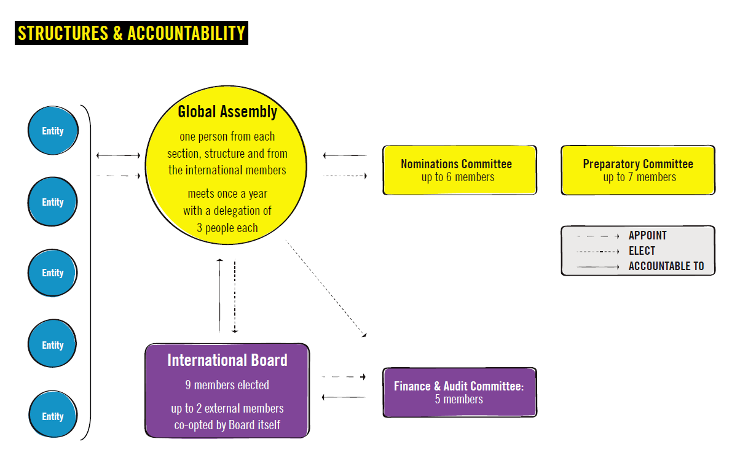
Proposed global governance model:

Slide 7
issues before the 2017 council: organization
Coordinated budgeting by IS and AI Sections
Role of AI Sections/Structures
Supporting AI Sections Worldwide
Funding our Global Presence
May be combined
into one resolution

Slide 8
KEY ISSUES before the 2017 council: HUMAN RIGHTS POLICY
Military occupation
Position on the Occupied Palestinian Territories
Drug policies & human rights
Review of AI policy on abortion
Elections and democracy
Climate change
Rights of people with disabilities
Banks and arms trade
Further research on sex work issues

Slide 9
Brief Q & A
Youth from across the movement at the 2013 ICM

Slide 10
Breakout!
New governance model, including voting changes
AI policy regarding military occupations
Decriminalization of drugs
AI policy on elections and democracy
AI and civil disobedience

Slide 11
AIUSA 2017 ICM consultation
At the AGM:
ICM discussion session (Sunday, 8 am)
Global Governance Reform (Sunday, 12:35 pm)
After the AGM
Consultation Meetings with the ICM Delegation
To be scheduled
Email us: ICM2017@aiusa.org

